Slide 1
MIR Final Project
105022204 吳大均

Slide 2
EDM 副歌音樂架構分析
說明

Slide 3
Pre-Processing
Get Tempo
Cut Beat

Slide 4
Feature Extraction
Chomagram
FFT
…
Spectral Centroid

Slide 5
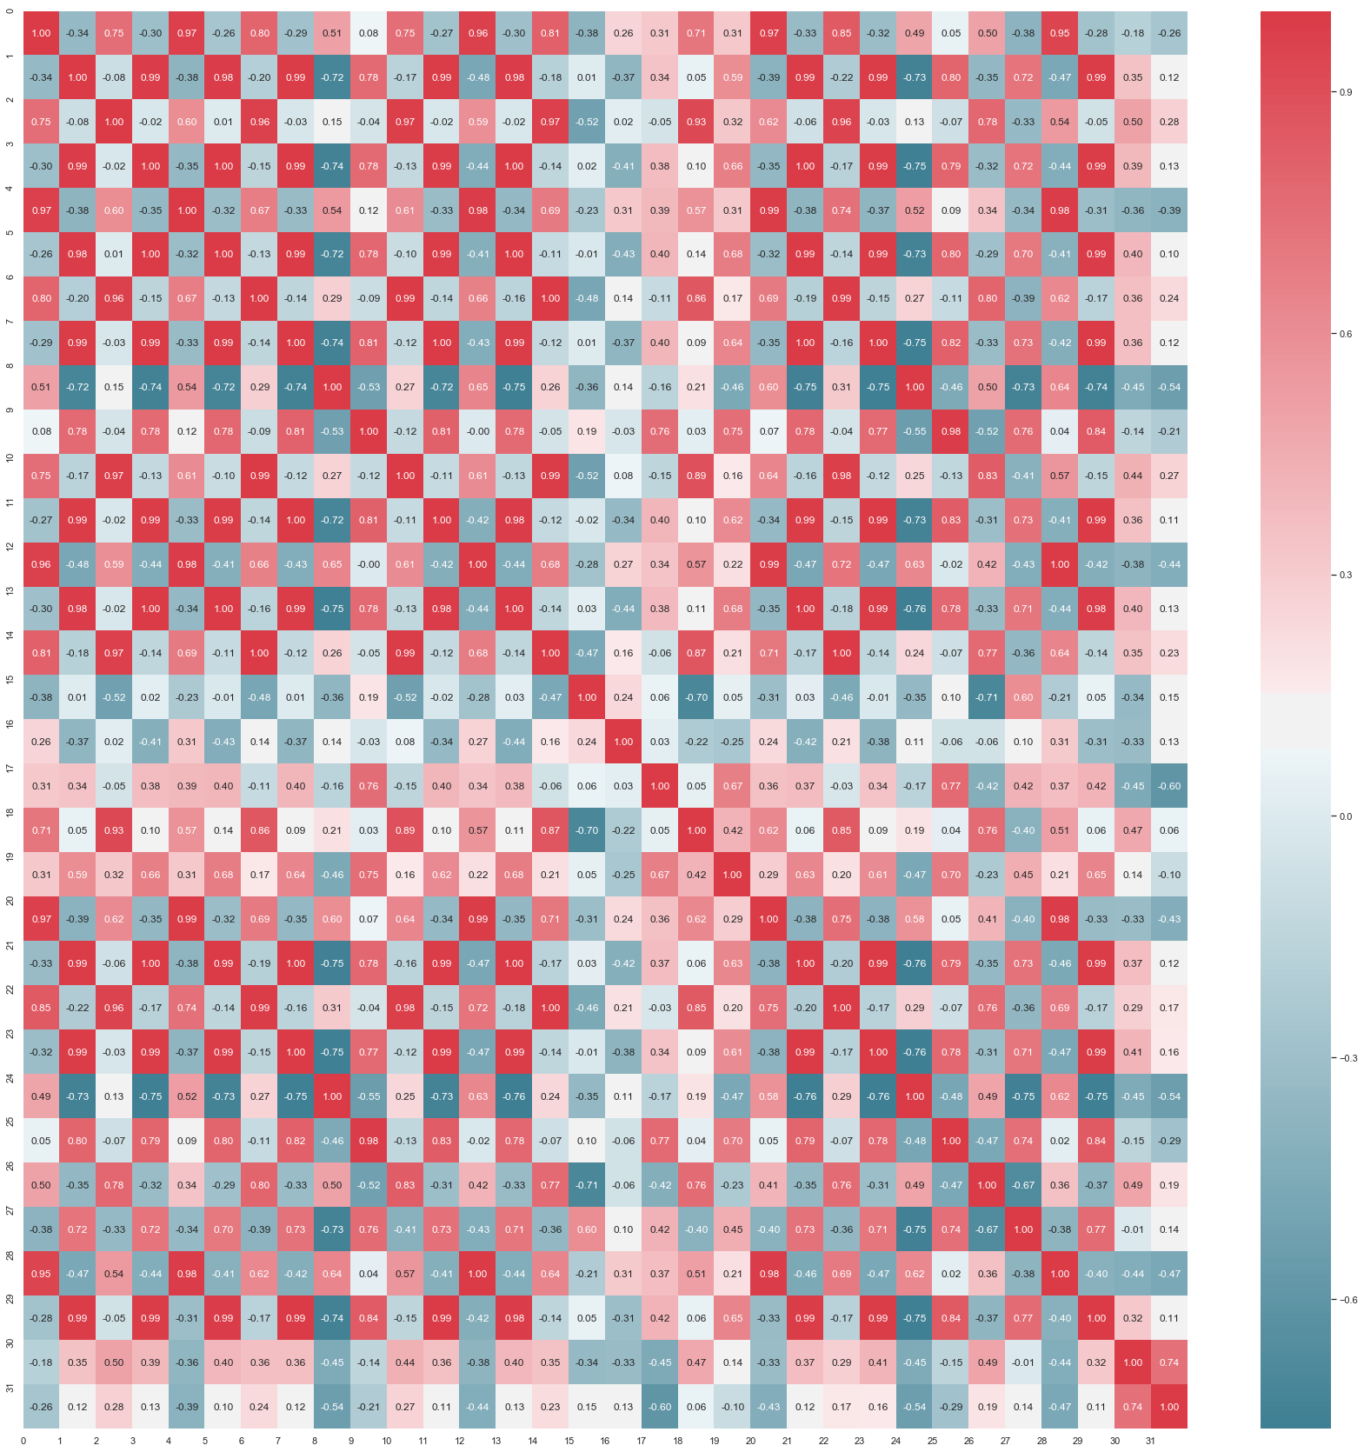
Beat SSM Matrix

Slide 6
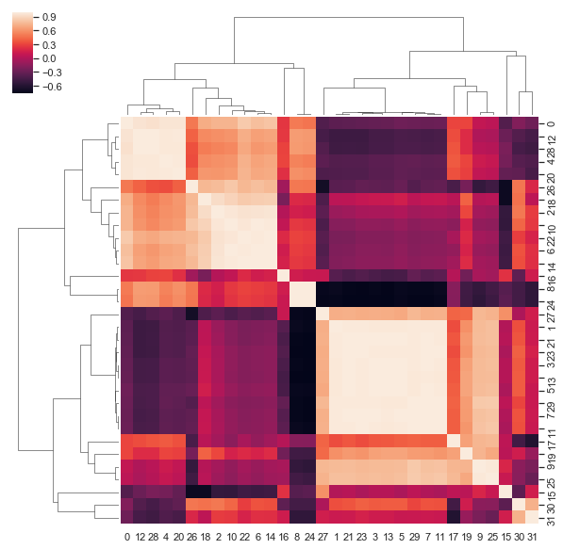
Cluster Beat

Slide 7
Cluster Meaning
Main Element
Fill

Slide 8
Result (Analyze 32beat For Demo)
0 | 1 | 2 | 3 | 4 | 5 | 6 | 7
8 | 9 | 10 | 11 | 12 | 13 | 14 | 15
16 | 17 | 18 | 19 | 20 | 21 | 22 | 23
24 | 25 | 26 | 27 | 28 | 29 | 30 | 31

Slide 9
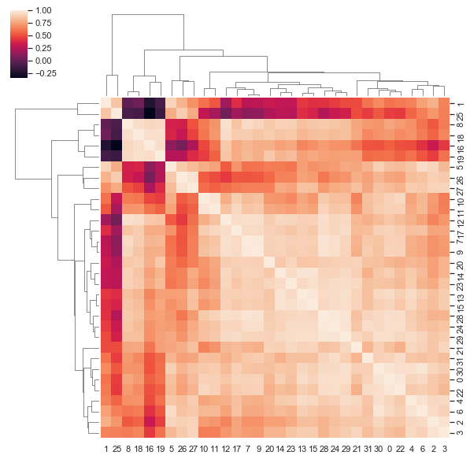
Test Melody
Better than Chomagram

Slide 10
Conclusion

